Slide 1
Game Engine Archetecutre
Milestone 1

Slide 2
01
02
What I have completed so far
Milestone marks I plan to hit
03
Performance

Slide 3
01
What I have completed so far
Model loading
able to apply UV textures to a model.
A skybox.

Slide 4
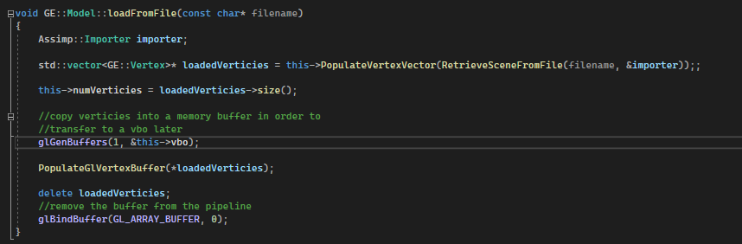
Model loading
The model class is able to load an obj file into the program to be renderered

Slide 5
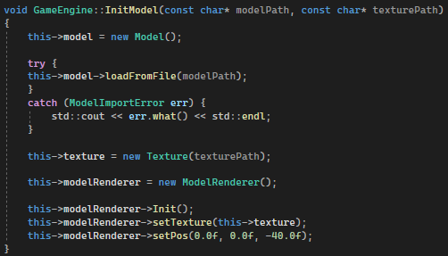
Usage
In the draw method

Slide 6
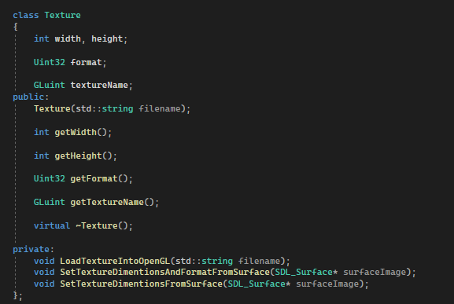
texturing
As shown in the previous slides when creating a model and its renderer you must also create a texture and give a reference to this texture to the model renderer. The texture is passed a filepath and loads the image from that filepath into a format that can be processed by OpenGL.

Slide 7
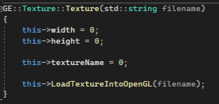
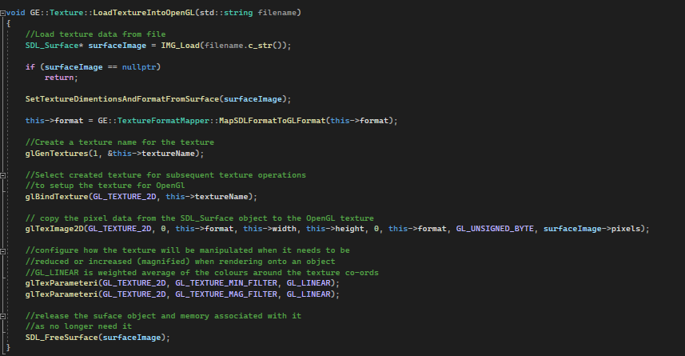
Texture CPP
Notes:
SetTextureDimentionsAndFormatFrom surface pulls this data out of the surfaceImage object and sets our format height and width member variables

Slide 8
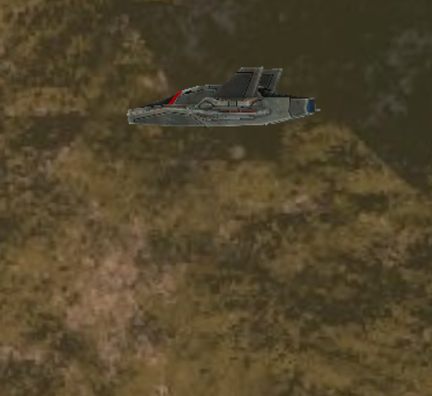
Textured Model Loading demonstrated

Slide 9
Skybox
I decided to use a skybox in my game. This is because I want the game to have a psx style. Many games that fit into this style were made before skysphereres had widespread adoption.
Some of the first games to use skyspheres was quake 3 and unreal tournament.
Aside from the fact using a skybox would be more faithful, I believe using a skybox would contribute to the visual style of my game better. Aside from this skyboxes generally have better performance

Slide 10
01 continued
Whats In progress so far
FPS controller
Loading 5 models
Terrain
Movement

Slide 11
FPS controller
I have followed the lab for the fps controller so all the code is there however it doesn’t really work. When you move the mouse around the camera rotates just not in the way you would expect

Slide 12
Skybox And Fps controller Demonstrated

Slide 13
Loading 5 models
The engine is able to load models into the scene I just haven’t put them in yet

Slide 14
Terrain
Like the fps controller I have followed the tutorials for the terrain however my code doesn’t work and the terrain doesn’t render ☹

Slide 15
WASD Movement
I have followed the fps camera tutorial however my code isn’t working and needs debugging

Slide 16
02
Planned milestones

Slide 17
50 – 59%
Dynamic models that move around the level in a pre-programmed or interactive way. These are in addition to the five static models/objects.
Implement a terrain based on a heightmap loaded from a file and applies a detail map.

Slide 18
60 - 69%
Collision detection that is more than the basic bounding box method described in sessions.
HUD (head up display) making use of 2D sprites.

Slide 19
> 70%
Post Processing effects
Lighting/Shadows
Special effects such as particle systems
Dynamic meshes such as for water
Ambient occlusion
Animated Character models.

Slide 20
03 Performance
Framerate, CPU and memory usage

Slide 21

Framerate
The game still runs at around 144 fps on my computer, and 60 fps on other monitors

Slide 22
CPU Usage
The cpu usage peaks at 1% at the start when the engine is first setting up and then runs at 0% stably

Slide 23
Memory Usage
The memory usage peaks at 84mb when the engine is setting up and then runs at a stable 59mb

